Slide 1
Software Product Line Engineering in Safety-critical Domains

Slide 2
1 Motivation

Slide 3
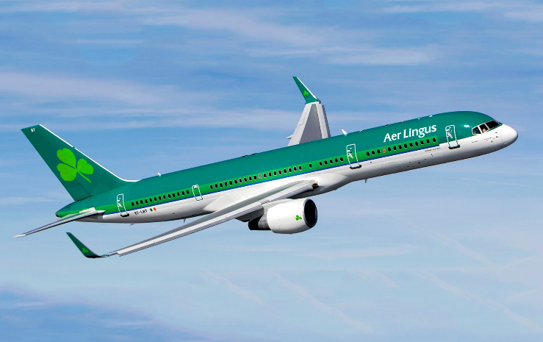
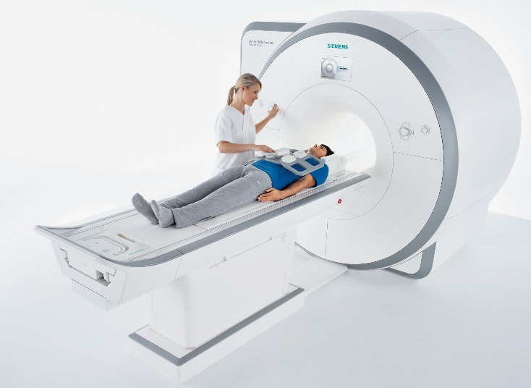
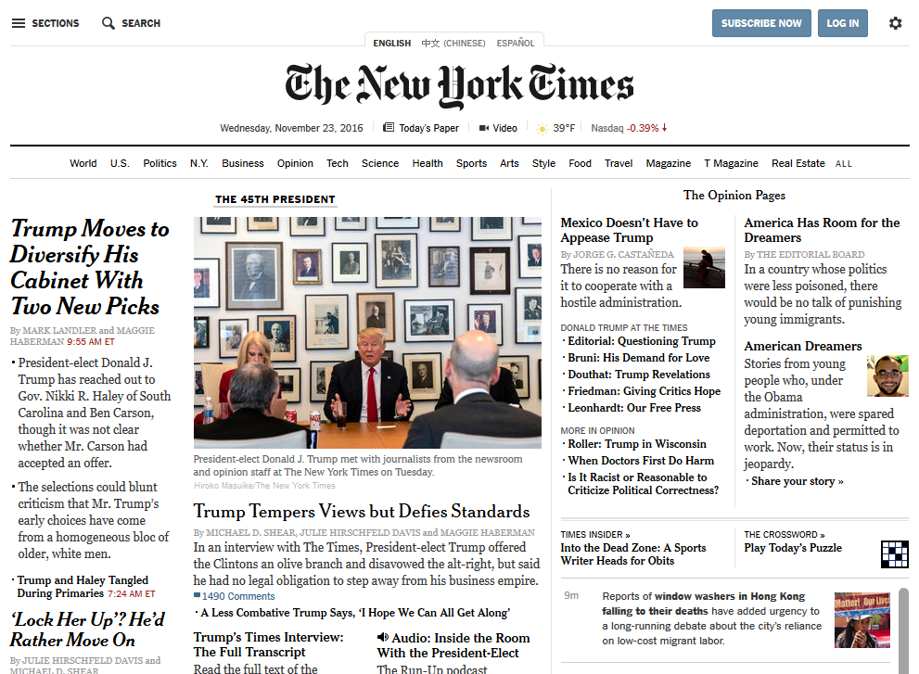
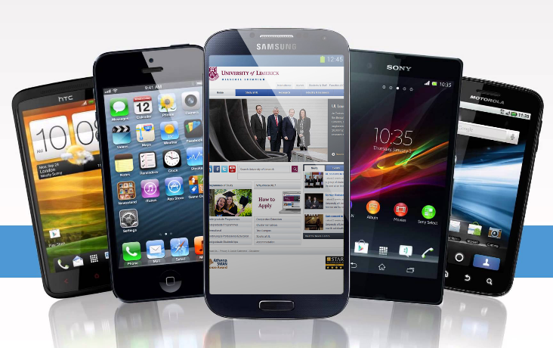
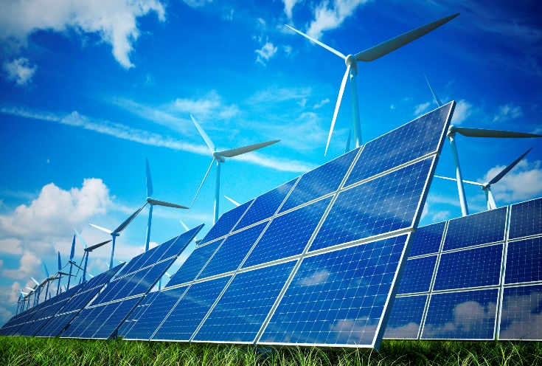
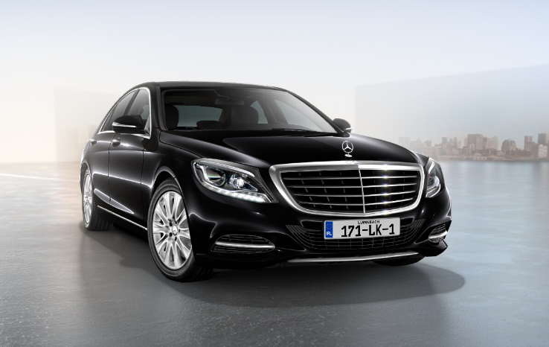
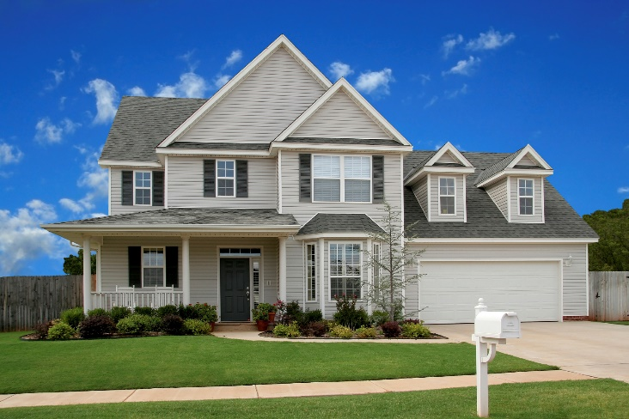
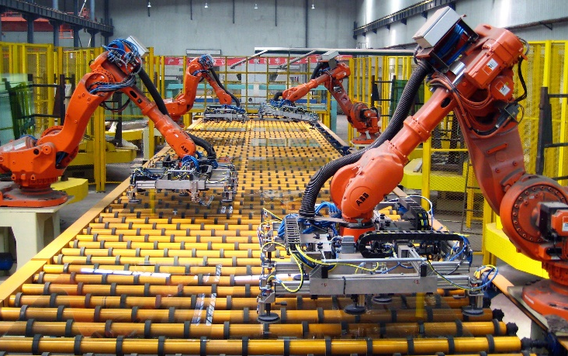
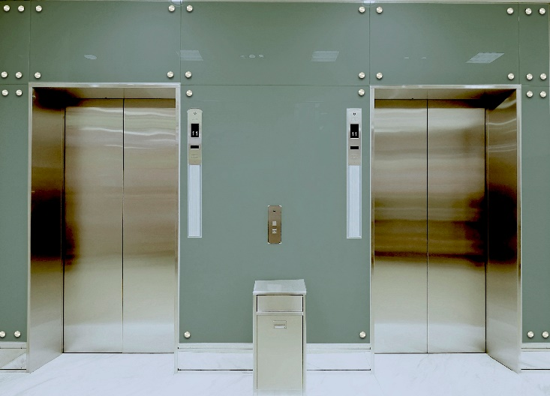
~150 Million lines of code
~100 ECUs (Electronic Control Units)
Notes:
What do we see here? There’s a plane, an MRI scanner, a house, a car, …
But what I actually see is software systems. Any system in our everyday life will become a software system.
Complex
150 Mio LOC. One thousand times as much as …
100 ECU, little computers
Many different aspects to consider, e.g., fuel consumption, safety, cost of manufacturing How do we build such a complicated system?

Slide 4
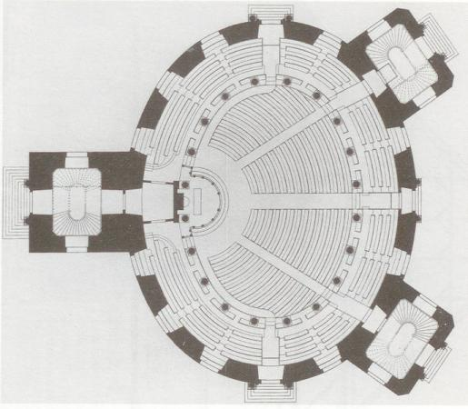
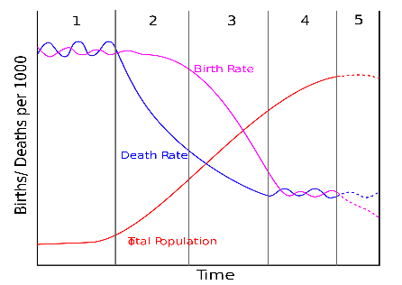
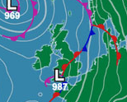
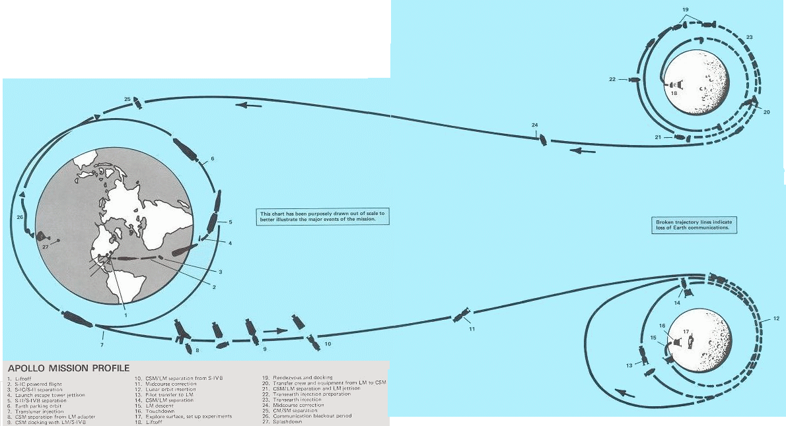



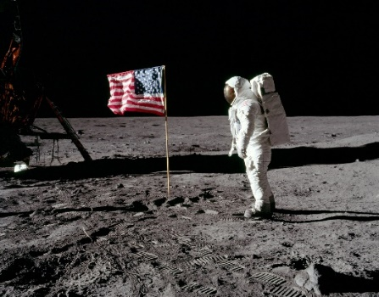

Models
Construction
Demographic Change
Weather
Spaceflight
Birthrate
Model
Death Rate
Total Population
Real World
Notes:
In science and engineering one way to gather knowledge and reduce complexity are models

Slide 5
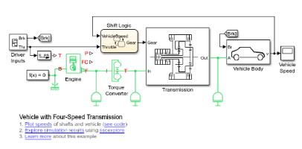


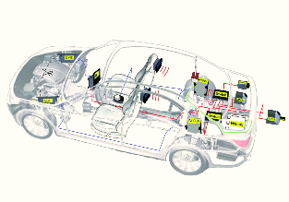
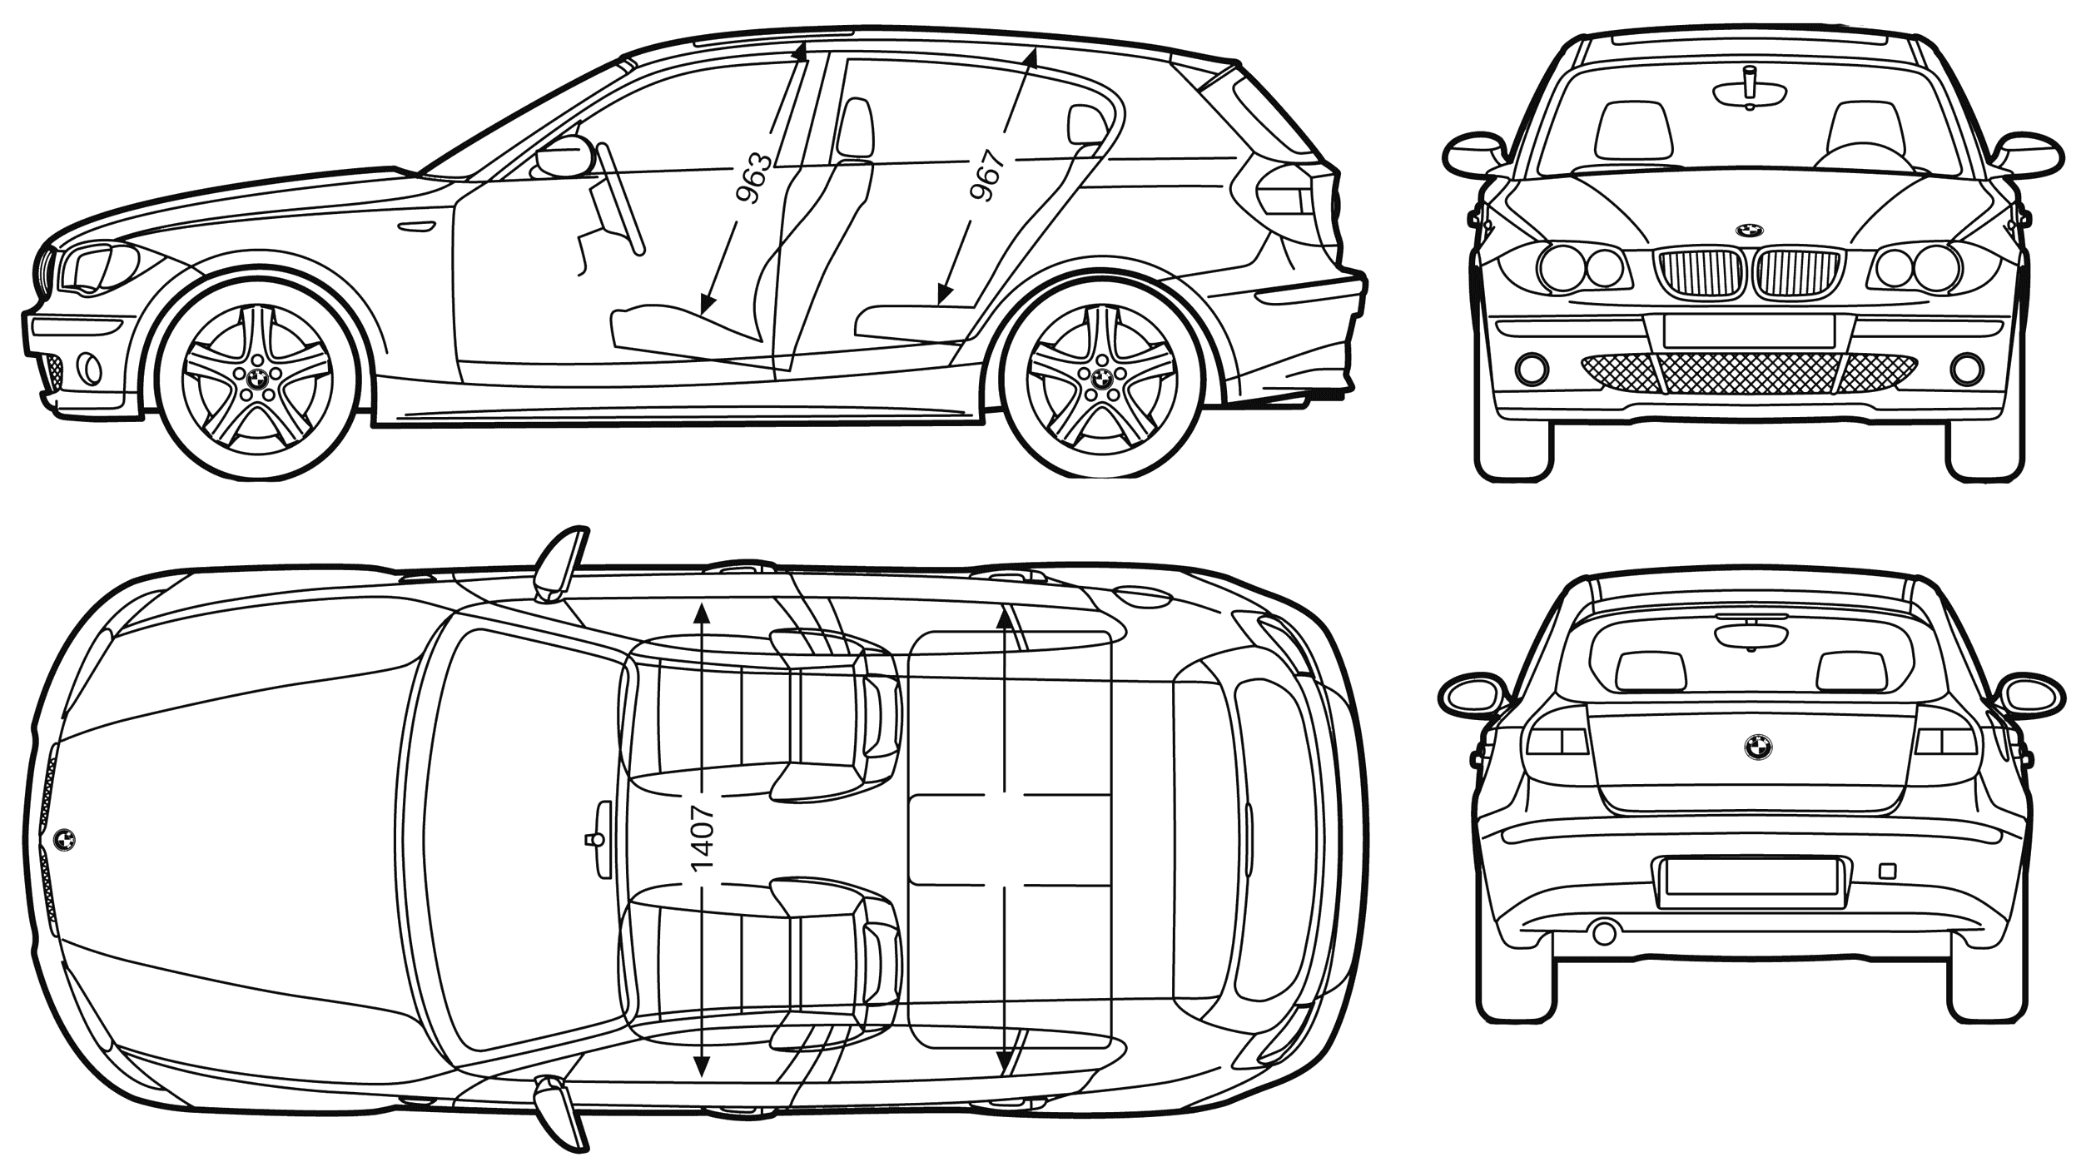
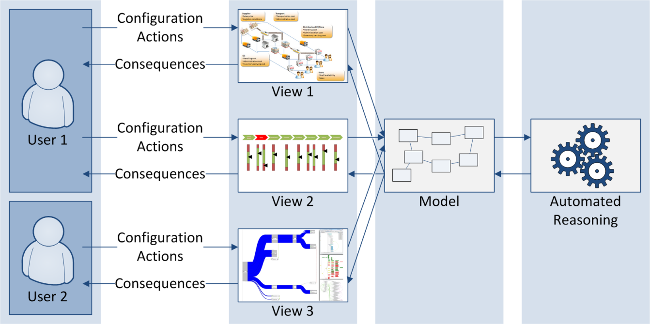
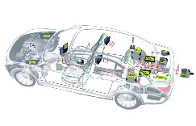
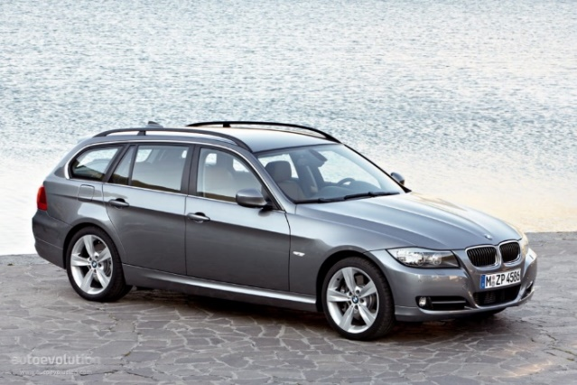
Model-driven Engineering
Formal Methods, Analysis,
Validation, Transformation
Visualisation, Interaction, Design
Model-driven Engineering
OK
Cancel
User
“The Model”
Efficient Creation
(Automated Generation)
Purposeful Abstraction
“The System”
[Stahl and Voelter 2006; Pleuss and Botterweck 2012]
Notes:
Automated generation: Just imagine constructing a house by taking a blue print and just pressing a button.

Slide 6

What is a „Model“?

Slide 7
What is a „Model“?
Representation of Reality
Abstraction
Focusing on the relevant aspects → Modelling purpose
Intentionally ignoring irrelevant details
Avoiding complexity and costs of reality

Slide 8
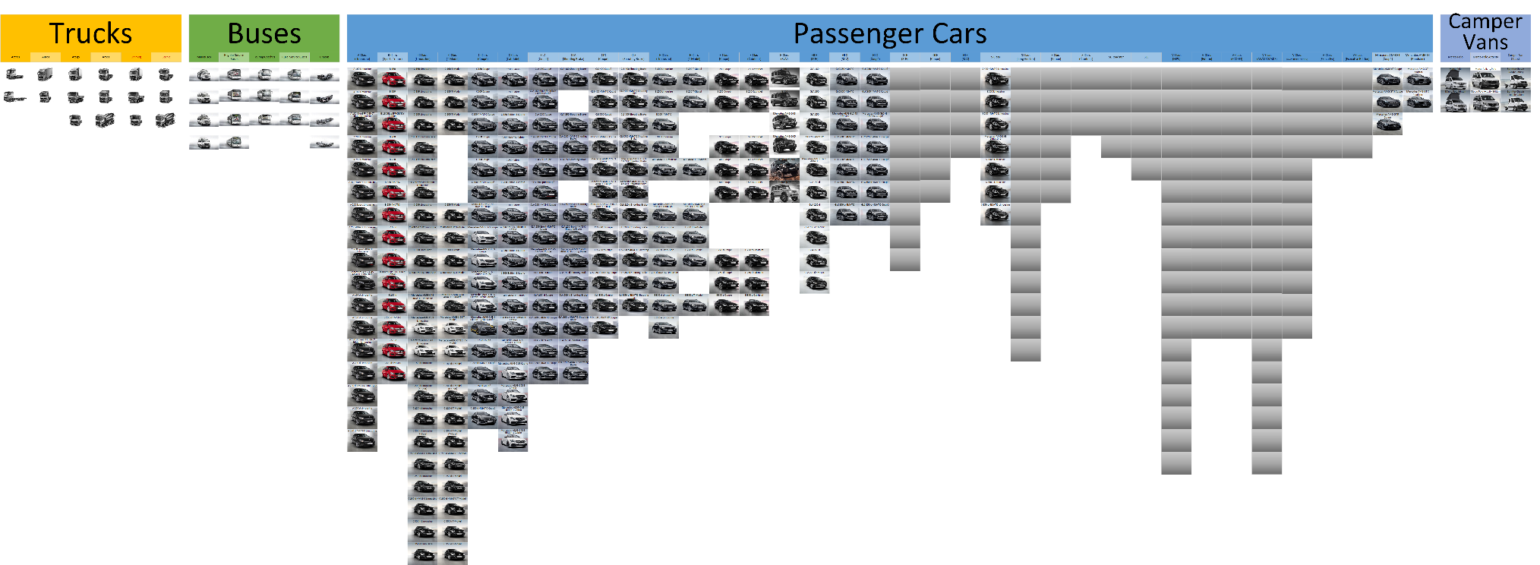
Many Variants
Source: Product info and configurators on http://www.mercedes.de
Notes:
Did not expand all the variants of trucks and buses.
And that is just the current new models that you can buy right now. We are not even considering

Slide 9
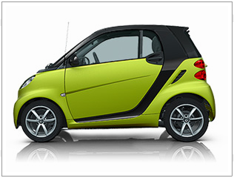
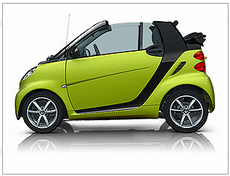
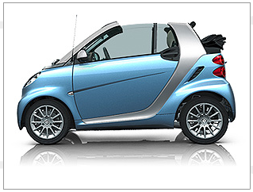
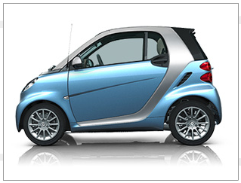
Origin of Product Lines
Sucessful Product → More Products → Product Portfolio
Few systems are truely unique
Strategic Reuse

Slide 10
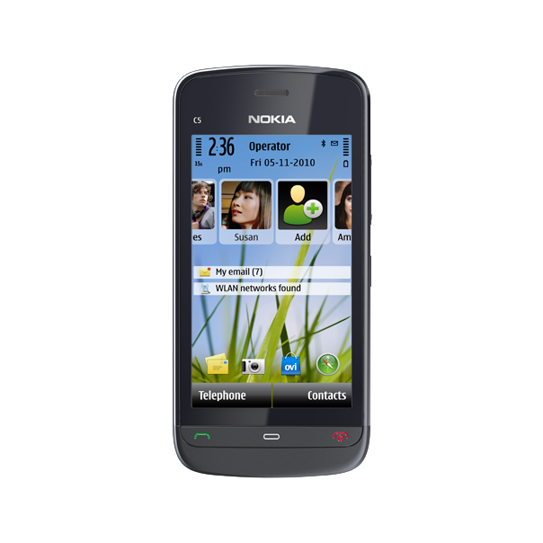
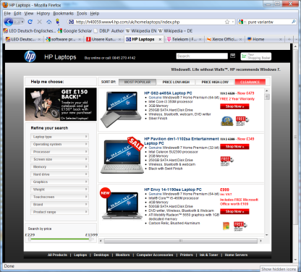
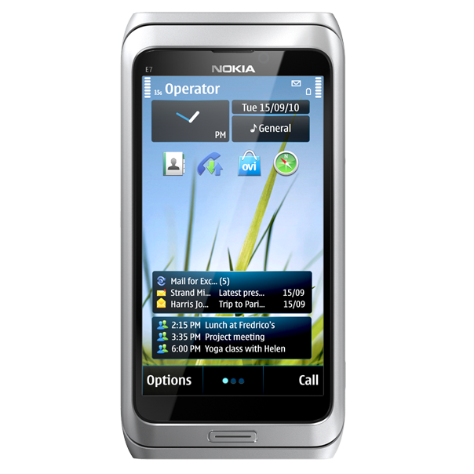
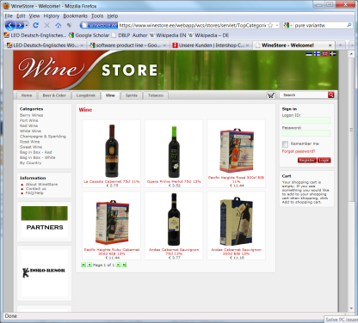
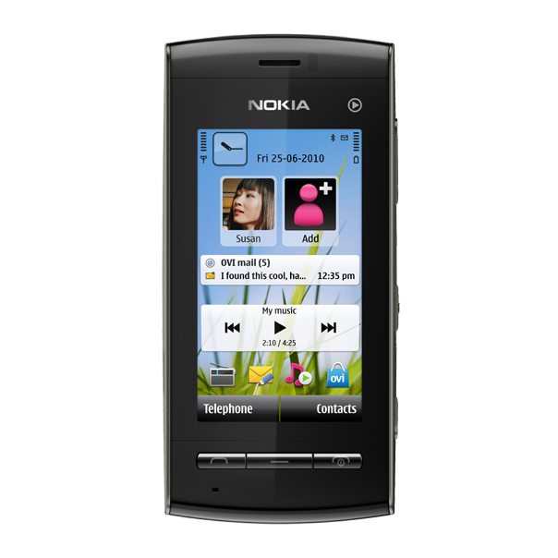
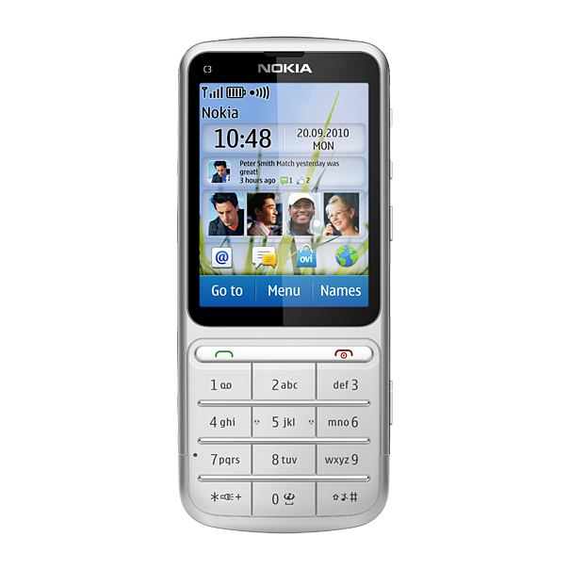
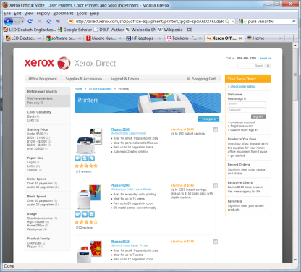
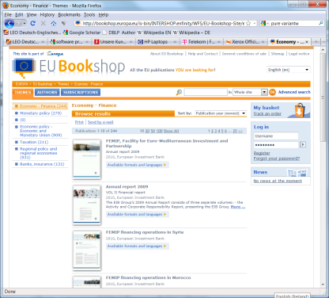
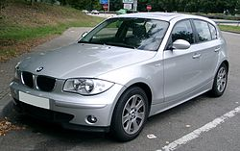
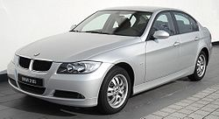
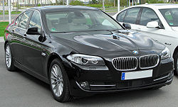
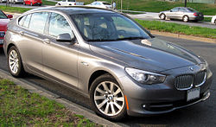
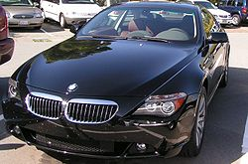
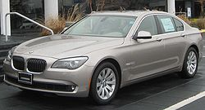
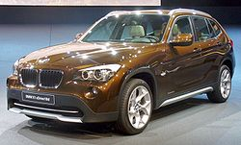
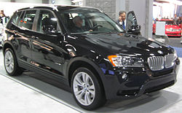
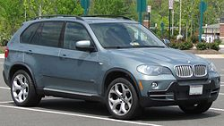
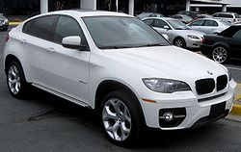
Product Lines

Slide 11
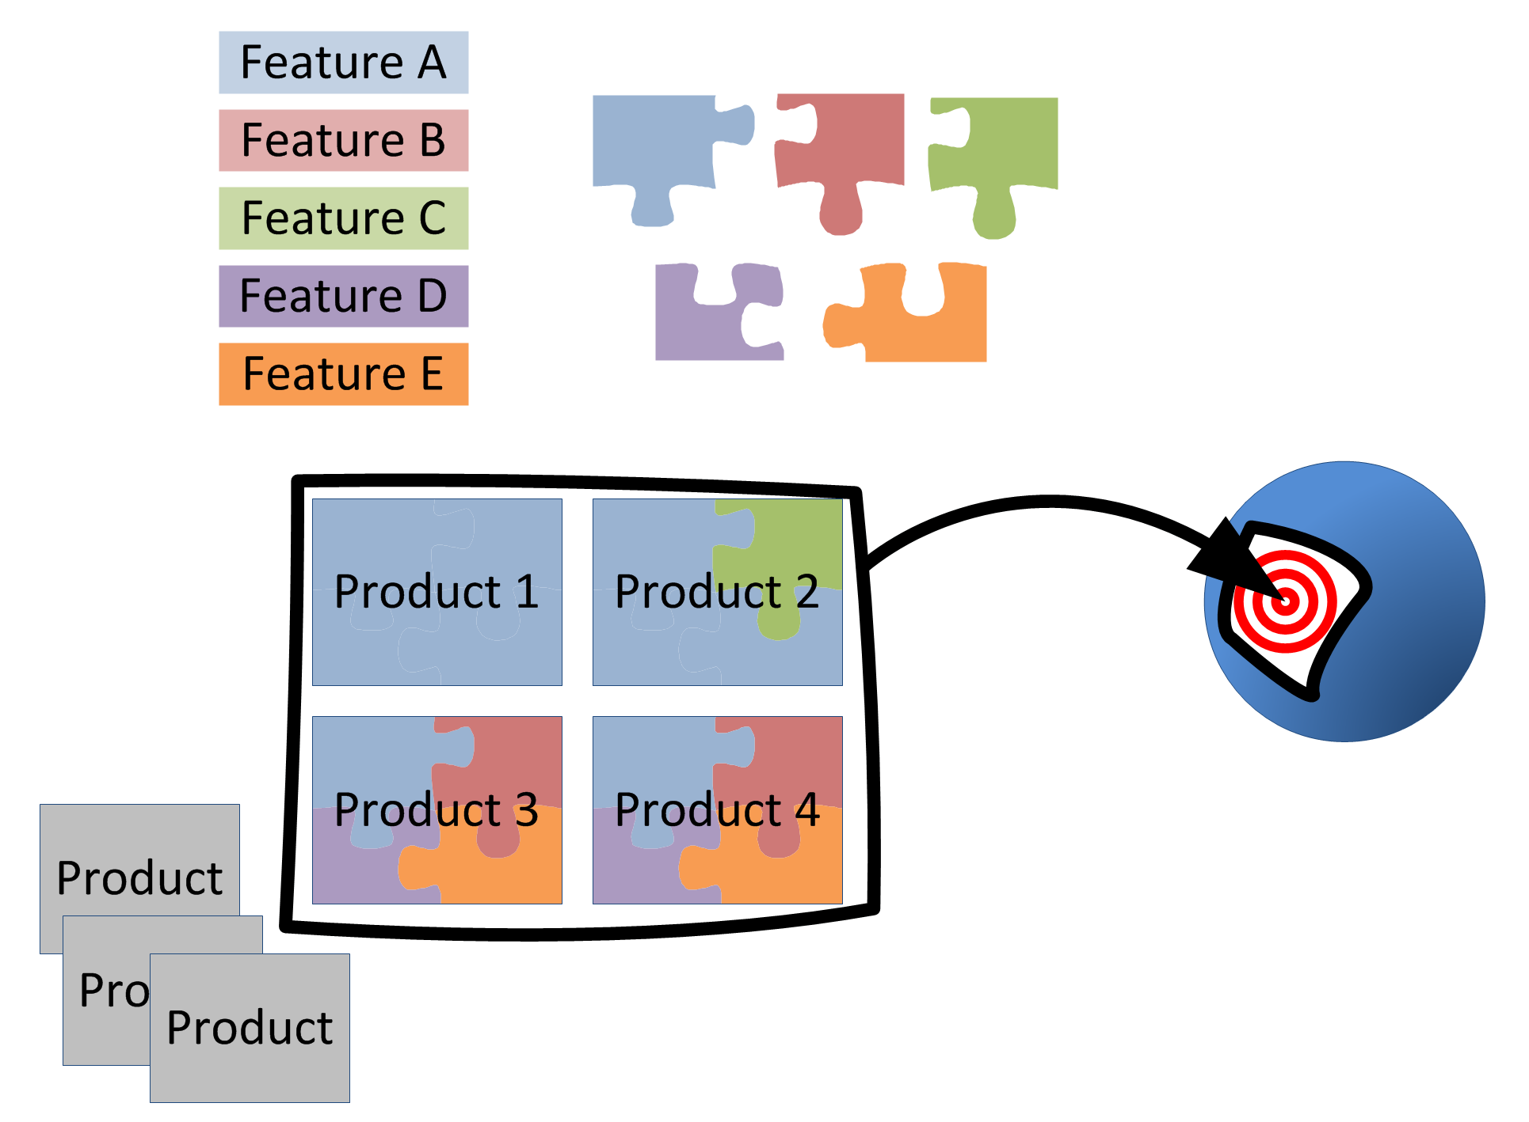
Product Lines
Developed from a common set of core assets in a prescribed way (strategic reuse)
Sharing a common, managed set of features
Targeting a market segment (scope)
Set of software intensive systems
[Clements and Northrop 2002]

Slide 12
2 Software Product Line Engineering

Slide 13
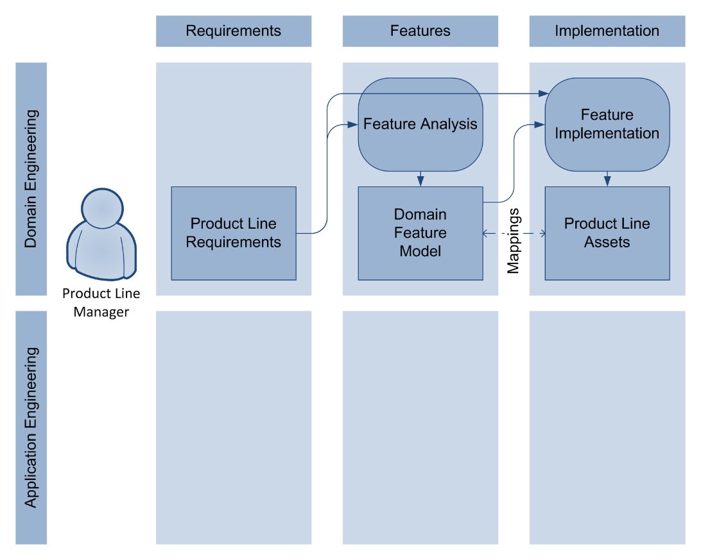
Product Line Engineering: Domain Engineering

Slide 14
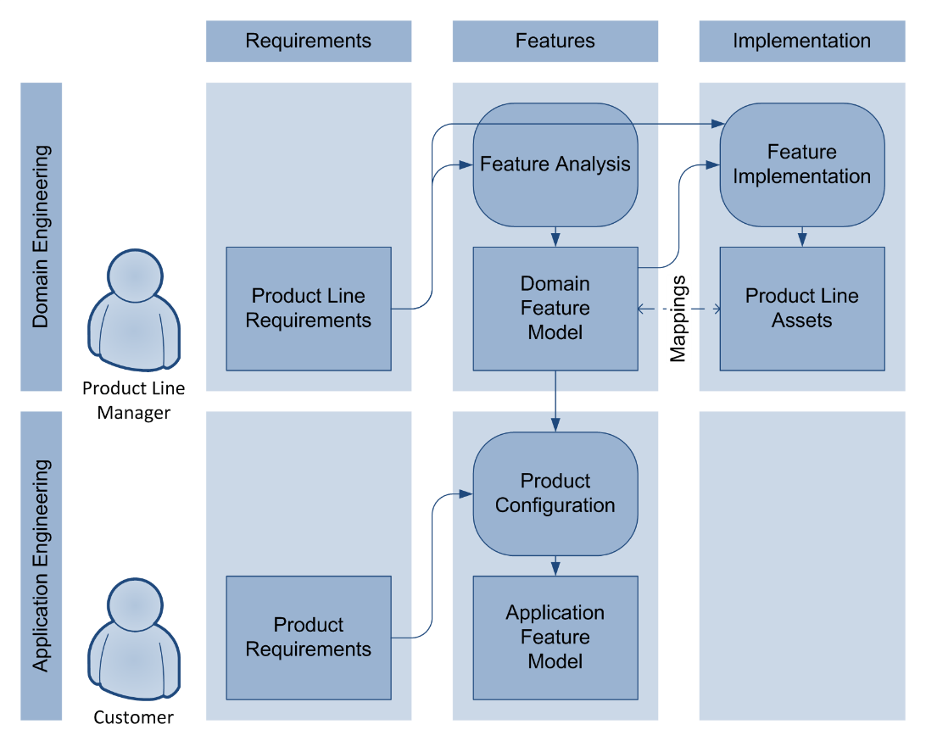
Product Line Engineering: Application Engineering

Slide 15
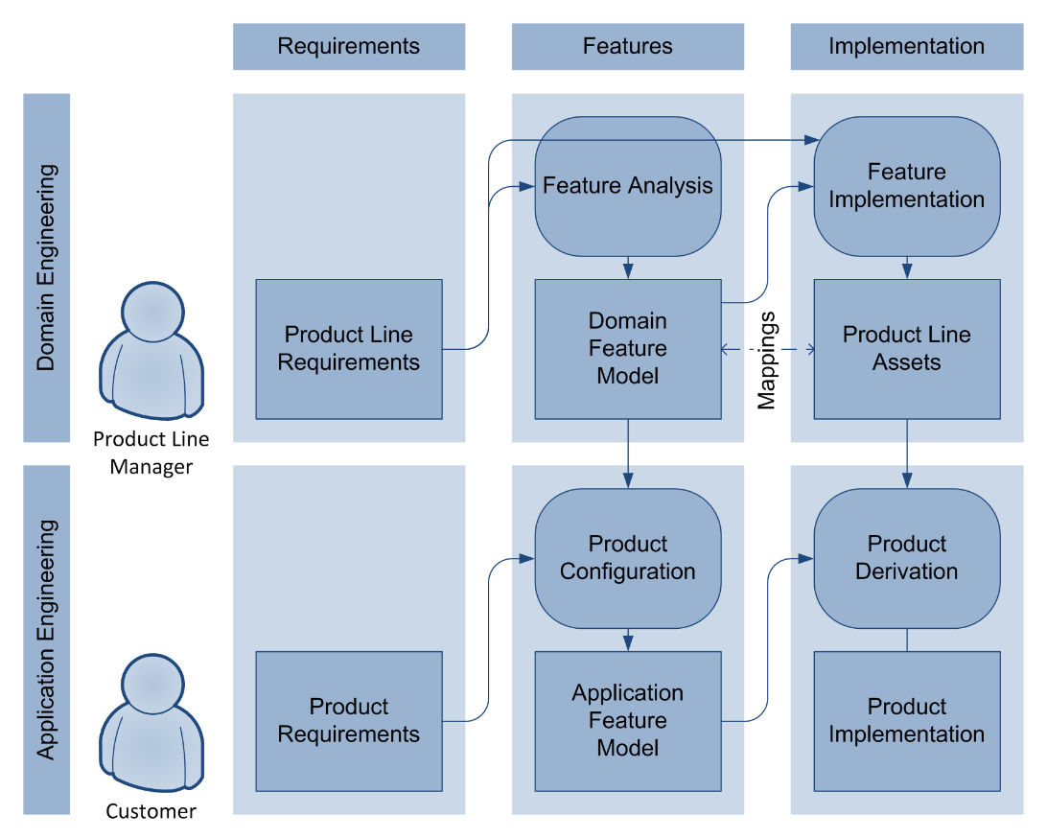
Product Line Engineering: Application Engineering

Slide 16
Product Line Engineering
Product Line Architecture
Product Line Assets

Slide 17
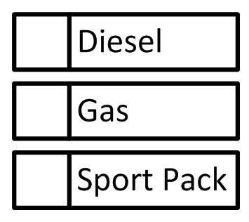
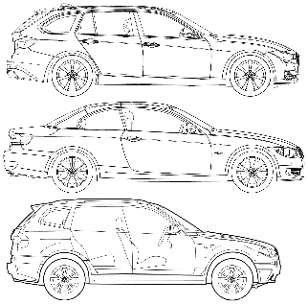
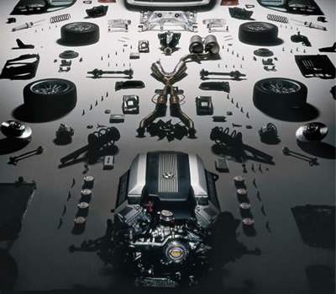

Product Line Engineering
Product Line Architecture
Product Line Assets

Slide 18
Product Line Engineering
Mapping required

Slide 19
2.1 Product Configuration

Slide 20

Product Line Engineering
Goal
Efficiency and Productivity
Scalability and Complexity Handling
by improving these processes

Slide 21
Product Line Engineering

Slide 22


Visualisation Techniques
Interactive techniques for the configuration of large and complex feature models [BSP09]
Co-configuration of feature and component models [BPK09]

Slide 23


Visualisation Techniques (continued)
2.5D and 3D visualisations in PLE configuration [CNP+08, CBH+09, CTB+09, CBH10, CHT+10]
Visualisation of product attributes during configuration [ScBo10]

Slide 24






Product Configuration (Integration of concepts)
[BJS09] Botterweck, G.; Janota, M. and Schneeweiss, D. A Design of a Configurable Feature Model Configurator, Proceedings of the 3rd International Workshop on Variability Modelling of Software-Intensive Systems (VAMOS 09), January, 2009 , 165-168

Slide 25



Configuration of Product Variants
Feature Model
Petrol xor Diesel
4 xor 6 cylinder
optional Sports Pack
Sports Pack requires 6 cylinder
Price [€]
Emissions [g CO₂/km]
Fuel consumption [l/100km]
configurations should conform to Feature Model
Petrol
4 Cylinder
yields product
€42,000
120 g/km
6.1 l/100km
No Sports Pack
Diesel
yields product
6 Cylinder
€55,000
136 g/km
5.2 l/100km
No Sports Pack
Petrol
6 Cylinder
yields product
€75,000
192 g/km
8.4 l/100km
Sports Pack
Notes:
One way to reduce complexity is to capture the available choices in a model
Choose product:
1) Provide interactive configurator, let user decide (but that would be another talk)
2) Look at product properties and try to find “the best” product

Slide 26

Multi-Objective Optimisation
Potential Products
Potential Products
Potential Products
Minimize
Goal: Optimize multiple objectives simultaneously
Minimize

Slide 27

Multi-Objective Optimisation
Pareto Front
Minimize
Named after Vilfredo Pareto
(1848-1923)
Goal: Optimize multiple objectives simultaneously
Minimize

Slide 28
Optimisation

Slide 29
2.2 Product Derivation

Slide 30
Product Line Engineering: Application Engineering

Slide 31


Product Derivation in a Embedded Systems DSL
[BPK09] Botterweck, G.; Polzer, A. and Kowalewski, S. Using Higher-order Transformations to Derive Variability Mechanism for Embedded Systems ACES-MB 2009, collocated with MODELS, Denver, CO, USA, October, 2009 , 68-82

Slide 32

Product Derivation in a Embedded Systems DSL
[BPK09] Botterweck, G.; Polzer, A. and Kowalewski, S. Using Higher-order Transformations to Derive Variability Mechanism for Embedded Systems ACES-MB 2009, collocated with MODELS, Denver, CO, USA, October, 2009 , 68-82

Slide 33

Product Derivation in a Embedded Systems DSL
[BPK09] Botterweck, G.; Polzer, A. and Kowalewski, S. Using Higher-order Transformations to Derive Variability Mechanism for Embedded Systems ACES-MB 2009, collocated with MODELS, Denver, CO, USA, October, 2009 , 68-82

Slide 34
3 Transition to SPLE

Slide 36
Different Approaches to Product Lines
Proactive
Develop PL assets first
Scoping, predictable target segment required
Upfront investment
Opportunity to structure PL and architecture as a whole
Reactive
Develop products first
Derive PL from products
Related approaches: Mining/Reverse Engineering
Incremental
Develop the PL in phases
Can be combine with both proactive and reactive approach

Slide 37

SEI Adoption Factory Pattern
[Clements et al. 2006, Northrop 2008]

Slide 38
4 Product Line Evolution

Slide 39

Product Line Evolution
[Botterweck and Pleuss 2014]

Slide 40

Product Line Evolution
[Botterweck and Pleuss 2014]

Slide 41

Product Line Evolution
[Botterweck and Pleuss 2014]

Slide 42

Product Line Evolution
[Botterweck and Pleuss 2014]

Slide 43

Product Line Evolution
[Botterweck and Pleuss 2014]

Slide 44

Product Line Evolution
[Botterweck and Pleuss 2014]

Slide 45
5 Variation/Automation and Quality

Slide 46

Verification and Testing

Slide 47
6 Successful in Practice

Slide 48
Prerequisuites
Enabling technologies: configuration/assembly of products (e.g. for software: OO, components, binding, ...)
Process maturity
Domain
Stability
Expertise, predictive knowledge
Otherwise: return on investment not possible

Slide 49

Develoment Costs
[Pohl et al. 2005, Weiss and Lai 1999]

Slide 50

Time-to-market
[Pohl et al. 2005]

Slide 51




Sucessful applied in practice, e.g.,
Avionics Systems
Engine Control Software
Marine Command and Control Systems
Telecommication Systems
Printer Firmware
RAID Storage Controllers
Financial Software
Mobile Phones
Medical Systems
Consumer Electronics
Acquisition Management Systems
Power Systems

Slide 52
Benefits of Product Lines
High quality
Reduced time to market
Market dominance
Market agility
Product alignment
Low cost production
Low cost maintenance
Mass customization
Reduced maintenance effort
Improved Efficiency and Productivity
[Clements and Northrop 2002, Northrop 2008]

Slide 53
Other effects
Scalability and complexity handling
Managment of evolution
Improved cost and time estimation

Slide 54
5 Current Research

Slide 55
Application of Machine Learning
Machine Learing in Configuration
E.g., learning a configuration space from a limited number of configurations

Slide 56
Design Space Exploration
Given constraints and objectives
Generate large number of potential designs (e.g., network structure, software architecture)
How to find and choose good designs?
How to find similar ones?

Slide 57
Summary

Slide 58


Summary

Slide 59
Summary

